Slide 1
21-1,2 West Africa
Physical Geography
And
History and Culture

Slide 2
Plains and Highlands
Cover most of region
Coastal plains has most of the cities
Tibesti Mountain
Northeast

Slide 3
Niger River
Starts in low mountains and empties into the Gulf of Guinea
Food
Farming
Transportation

Slide 5
Climate
Zonal – organized by zone
Humid tropical
Tropical savanna
Desert
Steppe

Slide 6
Sahel – strip of land that divides desert from wetter areas

Slide 8
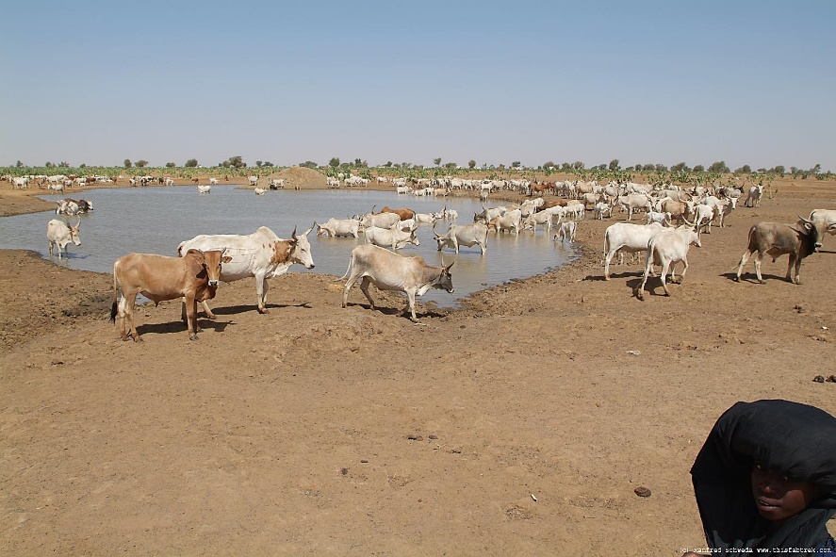
Desertification – spread of desert like conditions

Slide 9
Savanna – area of tall grasses and scattered shrubs and trees

Slide 11
Humid tropical
Rainforests

Slide 13
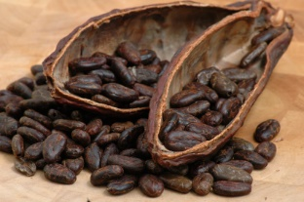
Resources
Agricultural
Cacao
Coffee
Coconuts
Peanuts
Oil
Minerals

Slide 14
Great Kingdoms
Trading centers developed into kingdoms
Ghana – gold and salt trade
Mali – used wealth to support artists and scholars

Slide 15
Songhai – university, mosques
City of Timbuktu – cultural center
Great trade cities faded:
Trade stopped
Europeans sailed along west coast
Didn’t need N. Africans that brought goods through desert

Slide 16
Slave Trade
Europeans and Africans profited at first
Demand grew – sold enslaved Africans to colonist
American colonies

Slide 17
Slave trade triangle
Middle Passage

Slide 18
Devastated region
Died on voyage across Atlantic
1800’s – millions of Africans enslaved

Slide 20
Colonial Era
Europeans wanted resources
France, Britain, Germany, Portugal – claimed colonies
Africans stopped farming and worked for low wages

Slide 21
Independence
After WWII
All colonies independent by 1974

Slide 22
Culture
100’s of ethnic groups
European boundaries – split groups
People are loyal to ethnic groups rather than countries

Slide 23
100’s of different languages
European influences

Slide 24
Religion
Lots!
Animism – belief that bodies of water, animals, trees, and natural objects have spirits

Slide 25
Sahel – Islam
South of Sahel
Europeans – Christianity

Slide 26
Clothes

Slide 27
Homes
Rural
Circular in shape
Straw, tin, mud
Extended families live together
City
High rise apartments

