Slide 1
Evolution of Stars
12-3,4

Slide 2
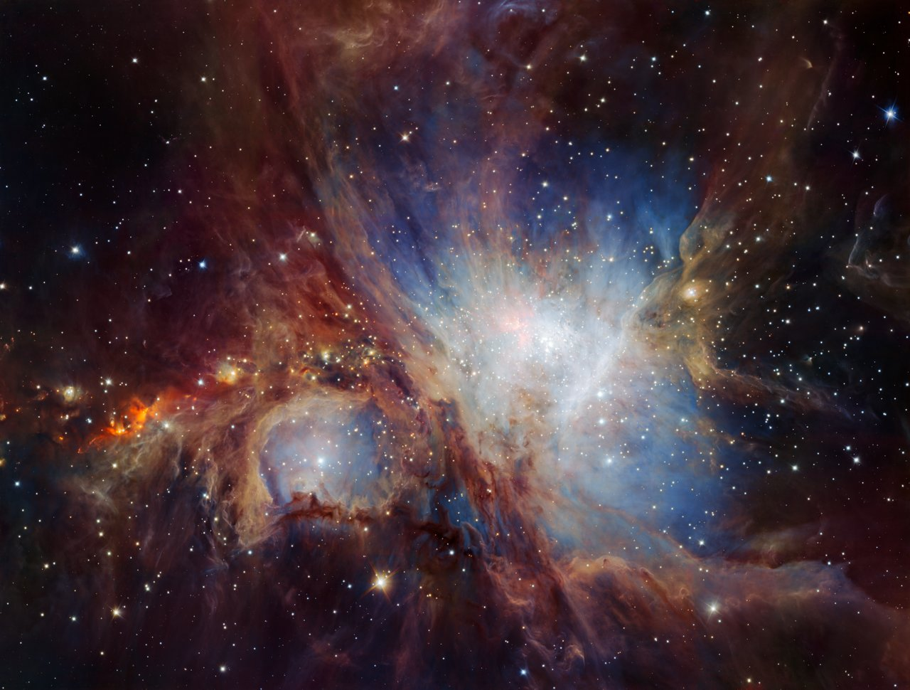
Birth of a Star
Nebula - Cloud of gas and dust
Protostars – dense area that collapses
  Hot and dense enough to start nuclear fusion

Slide 3
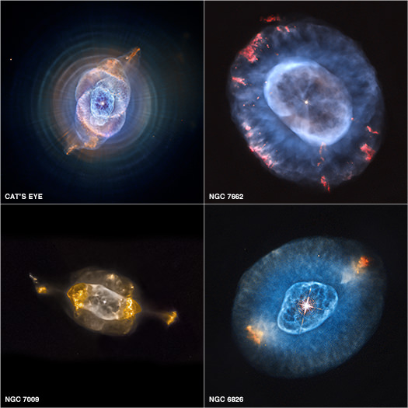
Surrounding gases eventually move away
Some material can form planets

Slide 4
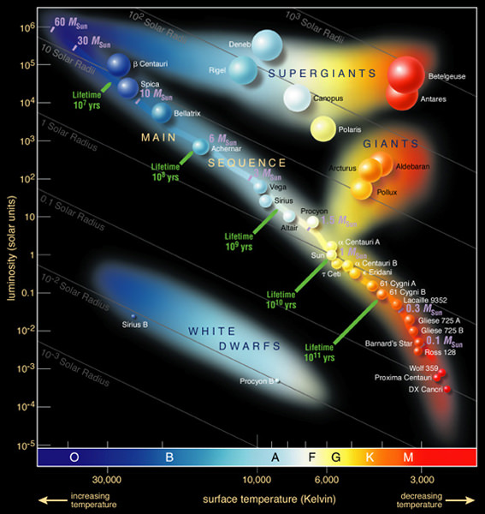
Main Sequence
Fuses hydrogen into helium

Slide 5
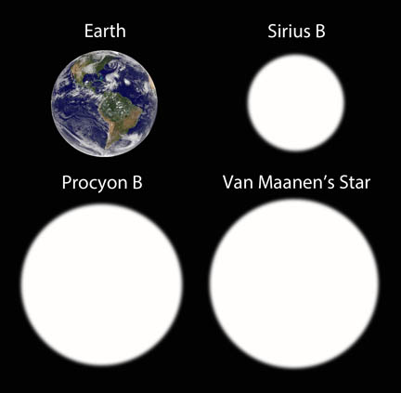
Star Death
White Dwarf – hot, dense, slowly cooling sphere of carbon
After helium is used up
Sun – 5 billion yrs
Red Giant – out to Earth?

Slide 6
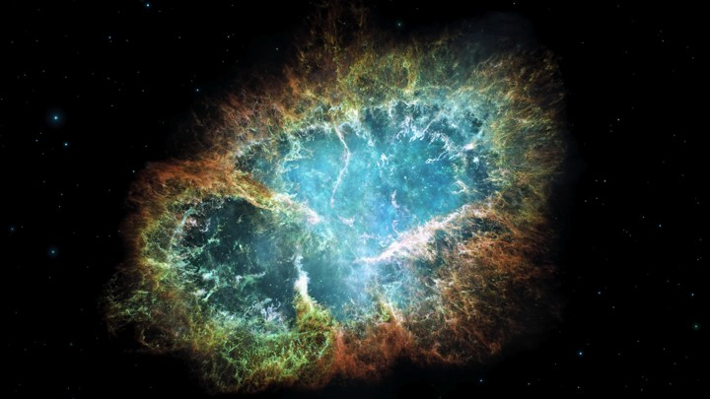
Supernova- explosion that destroys a star
10x the mass of the Sun
Iron forms in core
Stable and won’t fuse
Core collapses

Slide 7
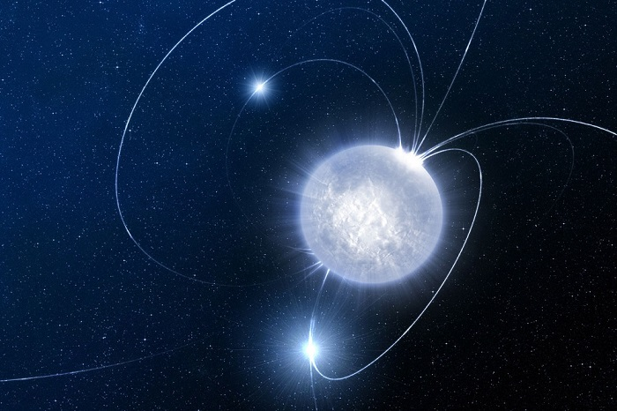
Neutron Star – dense core of neutrons that remain after supernova
So dense that a teaspoon would weigh more than 1 billion tons

Slide 8
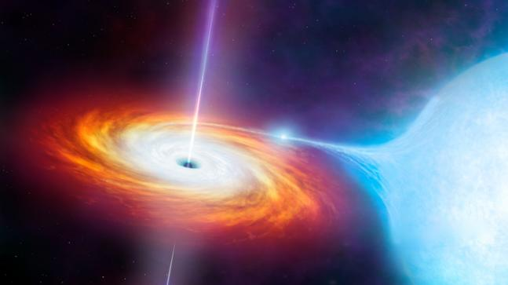
Black Hole – gravity is so great that no light can escape
Can’t see
Infer – If a star is circling around something but you can’t see anything in the center

Slide 9
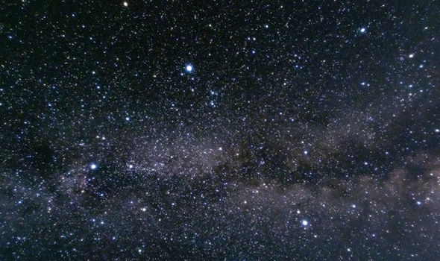
Recycling Matter
Remnants of old stars can form new stars

Slide 10
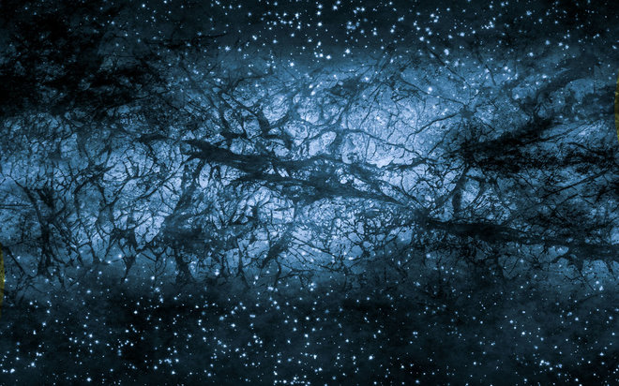
Dark Matter
Emits no light at any wavelength
90% of the universe
Not fully understood
Light bent without explanation
Stars orbiting faster than they should

Slide 11
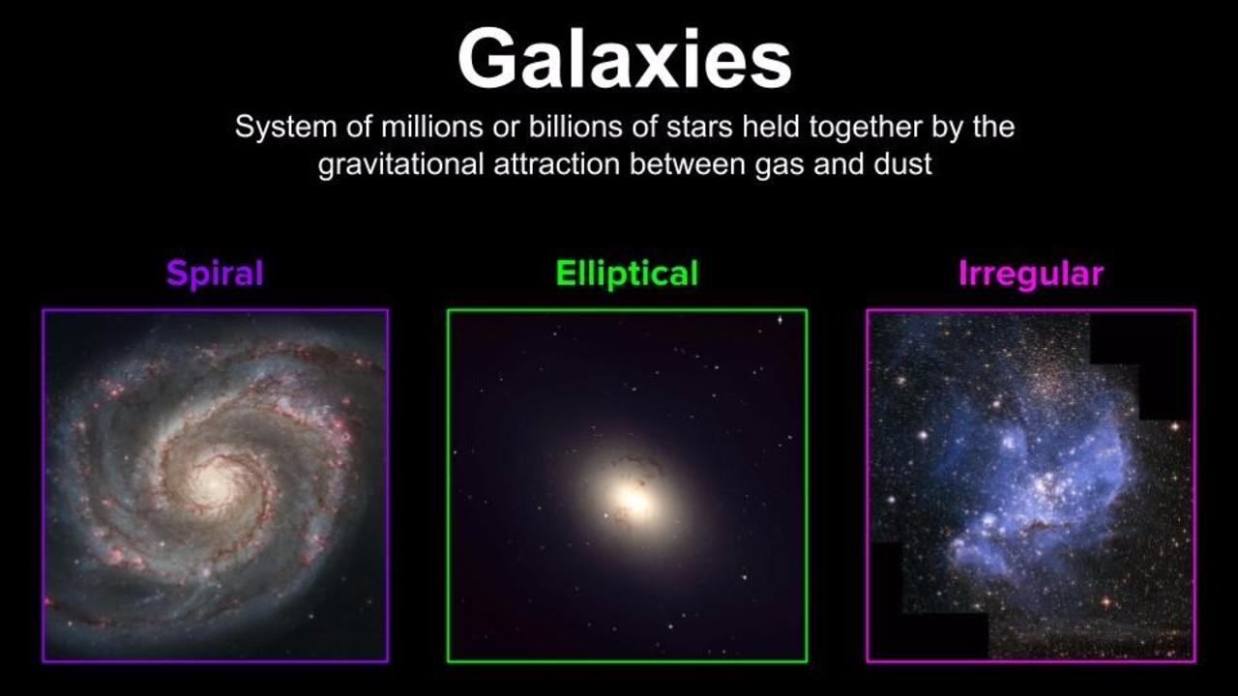
Types of Galaxies

Slide 12
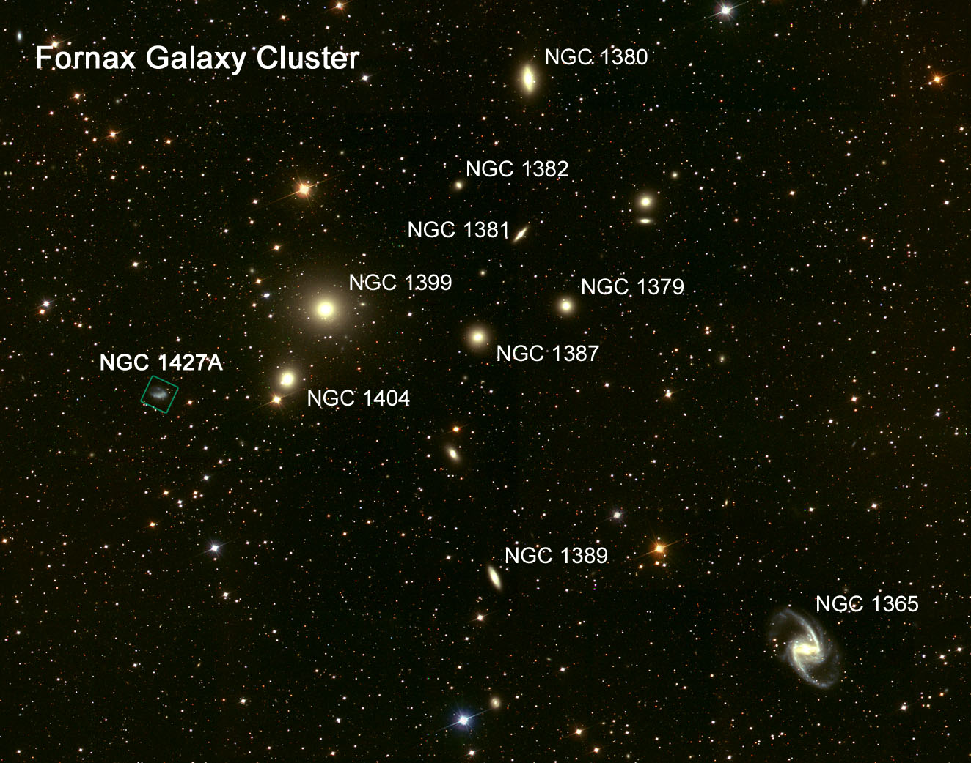
Groups of Galaxies
Clusters of galaxies
Clusters make up superclusters
Empty space between

Slide 13
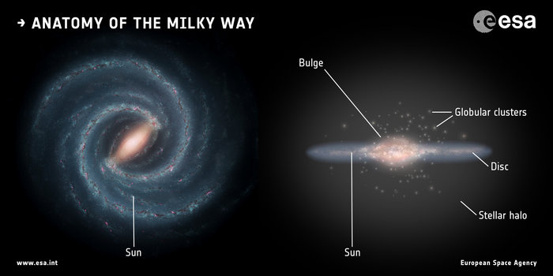
The Milky Way
Spiral
200 billion stars
Local Group – cluster of 30 galaxies
Collide with Andromeda in 3 billion years
  So large stars are not likely to collide

Slide 14
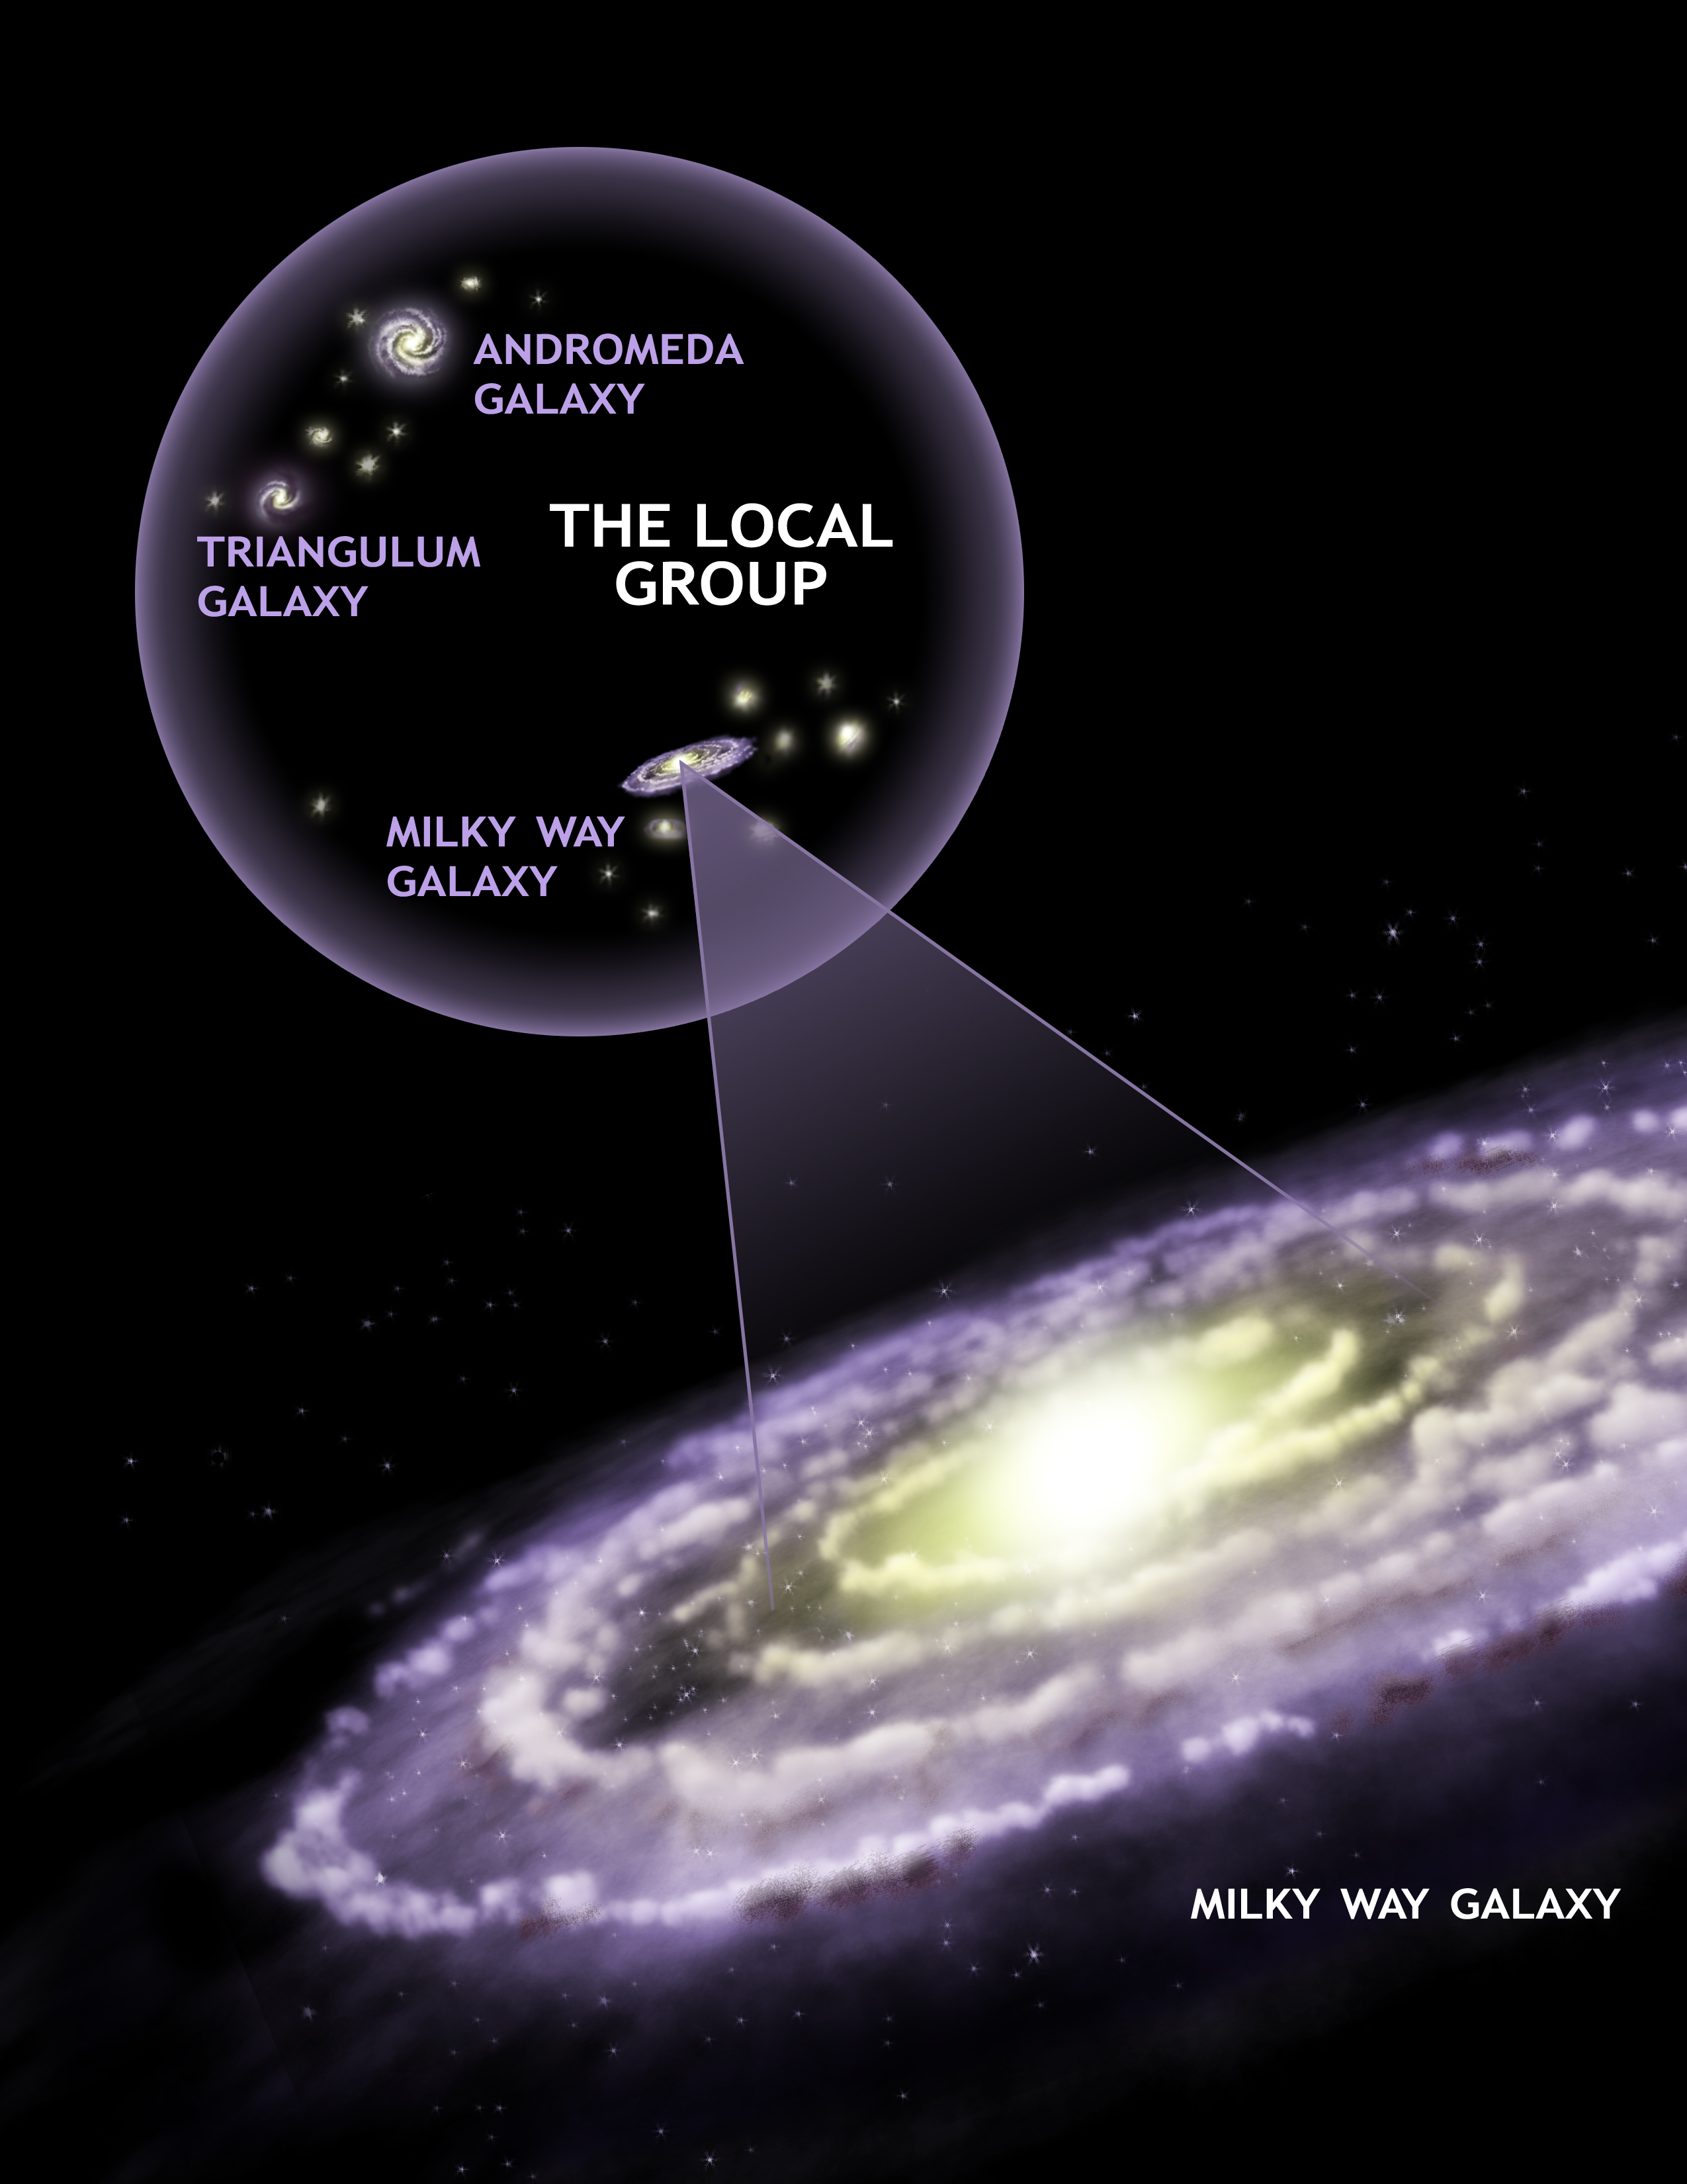

Slide 15
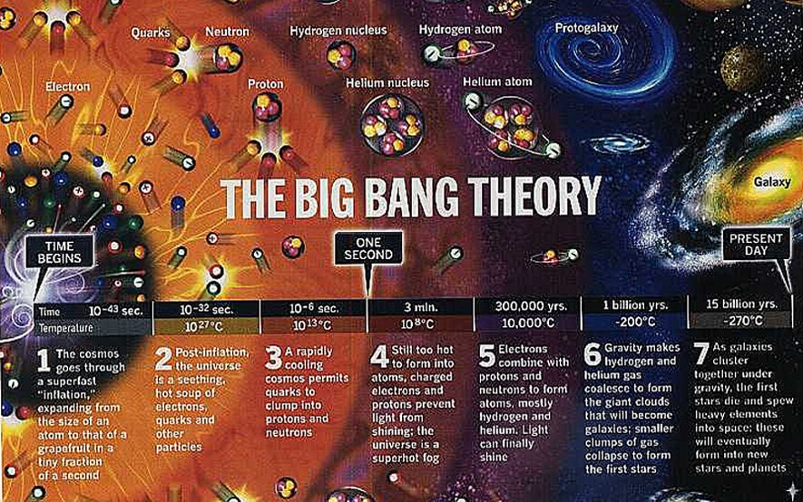
The Big Bang
Universe became from one point billion of years ago
Expanding still
14 billion years old

Slide 16
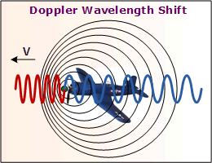
Doppler Shift
Shift to a different wavelength

Slide 17
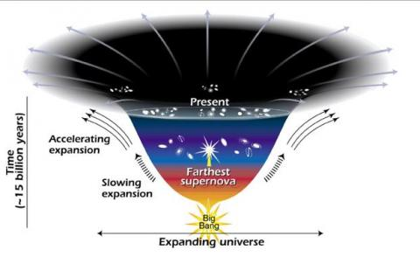
Dark Energy
Universe is accelerating as it expands out
Why?

