Slide 1
The Sun and Other Stars
14-2

Slide 2
How they Shine!
Hotter = more movement of atoms
More movement = More collisions
Nuclear Fusion – nuclei of several atoms combine into one larger nucleus

Slide 3
Stars
Nuclear Fusion = lots of energy
Star – large ball of gas held together by gravity
Core – so hot that nuclear fusion occurs

Slide 4
Stellar Composition
Hydrogen and Helium gas
Composition changes over time

Slide 5
Interior
Hydrogen fuses together to form helium
Helium is more dense – sinks to inner part of core

Slide 6
Interior
Radiative Zone – shell of cooler hydrogen above a star’s core
Light energy bounces from atom to atom on its way up

Slide 7
Interior
Convection Zone – hot gas move up towards surface
Cooler gas move in deeper

Slide 8
Atmosphere
Photosphere – surface of a star
Part you see
Looks smooth – Not!

Slide 9
Atmosphere
Chromosphere – Orange/red layer above photosphere

Slide 10
Atmosphere
Corona – Outermost layer
Hottest part of atmosphere

Slide 11
Sun Spots
Strong magnetic activity
Cooler – appear dark
Size of Earth

Slide 12
Prominences and Flares
Prominences - Clouds of gas that make loops
Last for weeks
Flares – Bright violent eruptions
Last for minutes or hours

Slide 14
Coronal Mass Ejections (CME’s)
Huge gas bubbles
Larger that flares
Hours
Material can reach Earth – radio blackouts

Slide 16
Solar Wind
Charged particles that stream away from the Sun
Pass Earth and go to edge of Solar System

Slide 18
Auroras
Light created when solar wind or CME interact with the Earth’s magnetic field

Slide 20
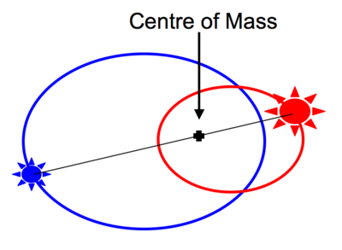
Groups of Stars
Single – Sun
Binary – 2 stars orbit each other
Most common
Globular - clusters

Slide 22
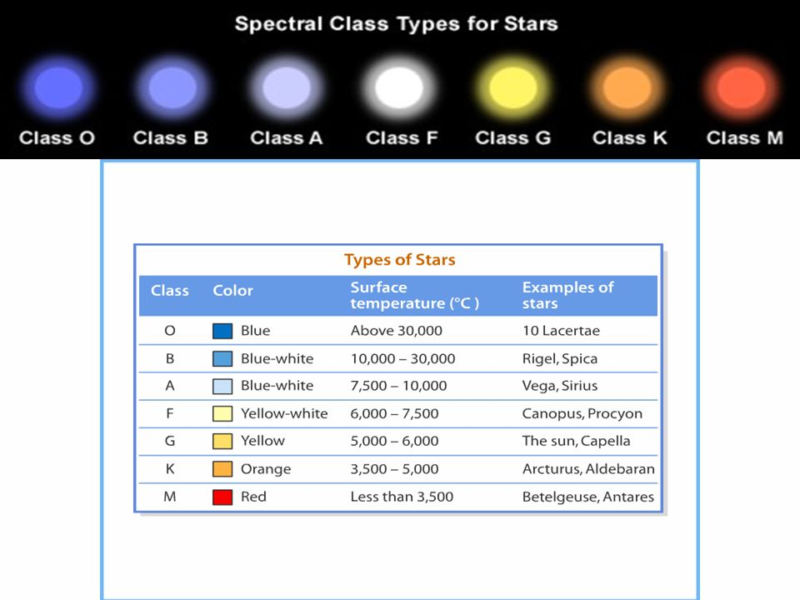
Temperature, Color, and Mass

Slide 23
Hertzsprung – Russell Diagram
Graph that plots luminosity vs temperature

Slide 24
The Main Sequence
Most stars spend the majority of their life here

