Slide 1
Dwarf Planets and Other Objects
11-4

Slide 2
Dwarf Planets
2006 – International Astronomical Union
Orbits Sun
Enough mass and gravity to form a sphere
Has objects similar in mass orbiting near it or crossing it’s path

Slide 3
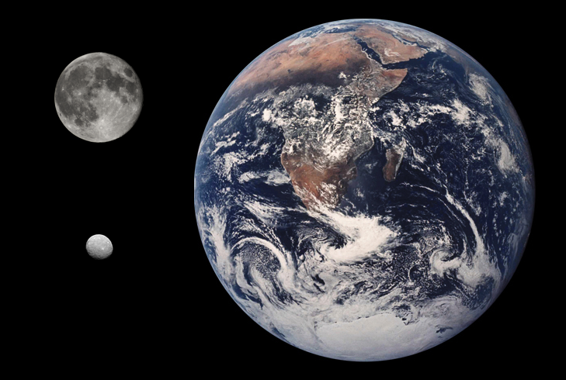
Ceres
Orbits the Sun in the asteroid belt
¼ size of the moon
Smallest

Slide 4
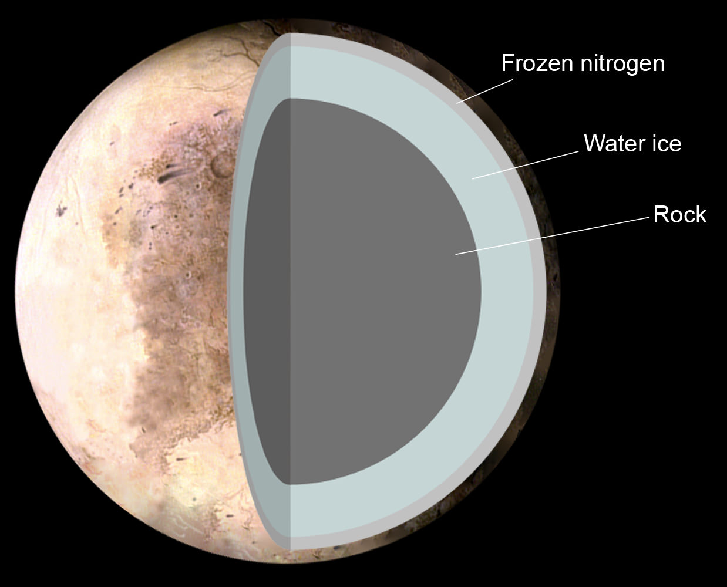
Pluto
2/3 the size of the moon
1 year = 248 years
Rocky core surrounded by ice
-230 C
Frozen Nitrogen
3 moons

Slide 5
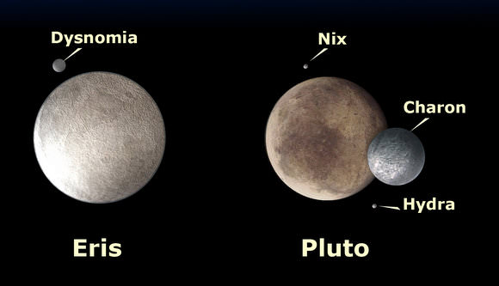
Eris
Largest
Discovered in 2003
3 times farther than Pluto
1 year = 557 years
1 moon

Slide 6
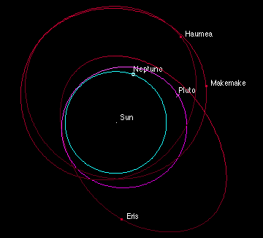
Makemake and Haumea
2008 – 2 new dwarf planets
Located in Kuiper belt

Slide 7
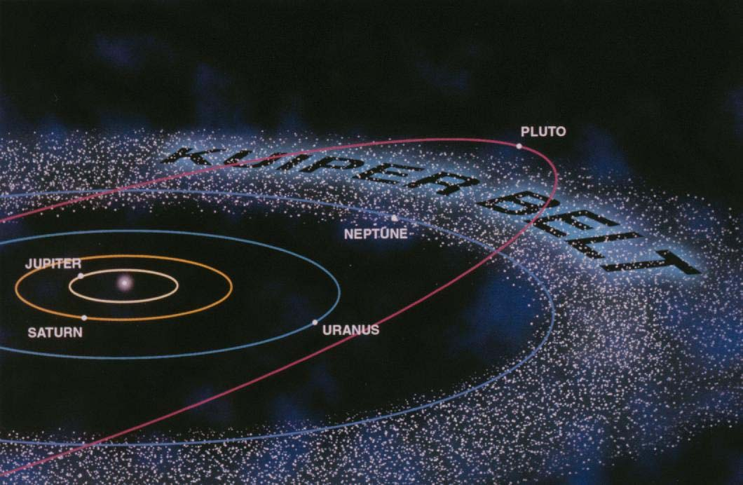
Kuiper belt
Region beyond Neptune’s orbit
Lots of small icy bodies

Slide 8
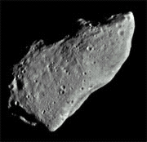
Asteroids
Rock and ice
Orbit the Sun
Don’t clump together like some of the inner planets

Slide 9
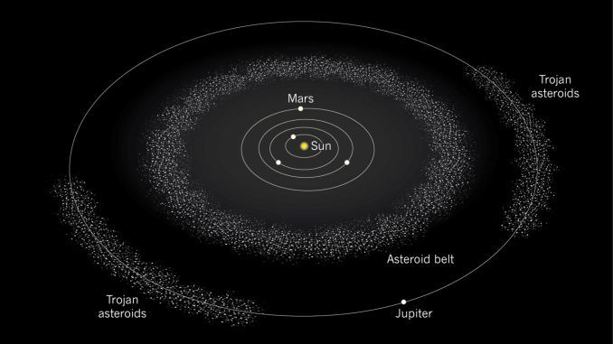
Asteroid Belt
Between Jupiter and Mars
Might have become planets if not for Jupiter's gravity

Slide 10
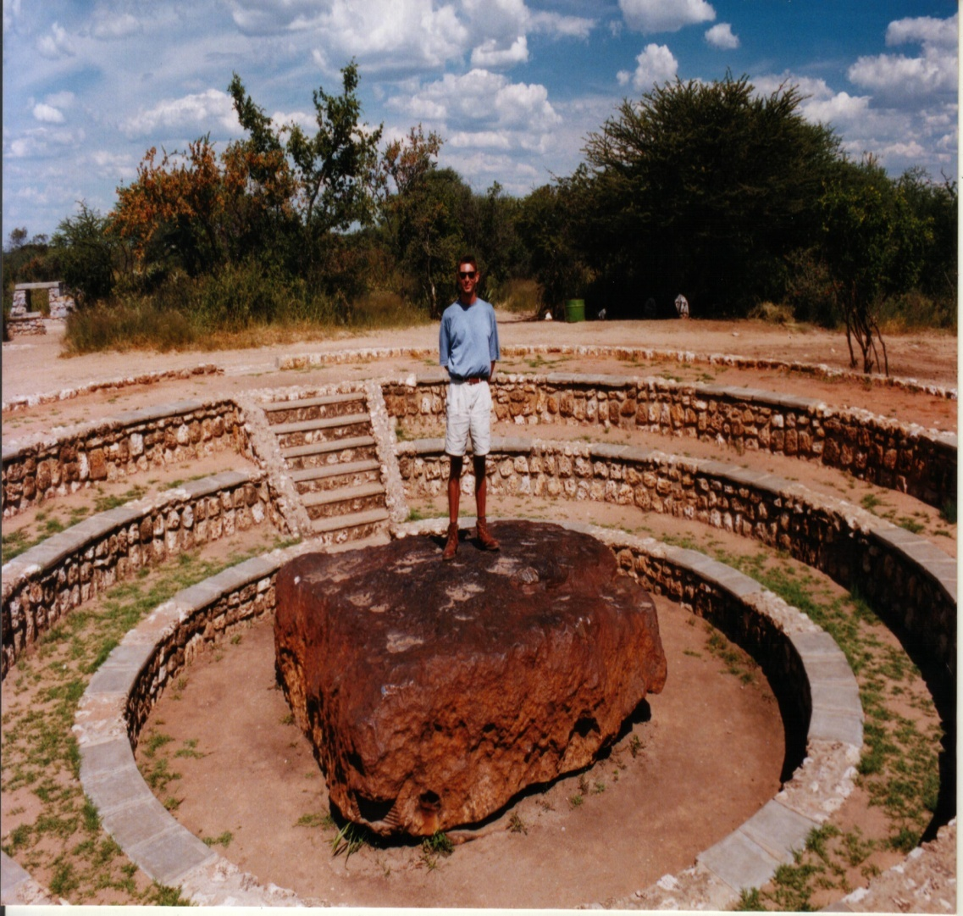
Meteoroids, Meteors, Meteorites
Meteoroid: small pieces of rock moving through the solar system
Meteor: Small piece of rock as it passes through the Earths atmosphere
Meteorite: Rock that did not burn up and made it to Earth’s surface.

Slide 11
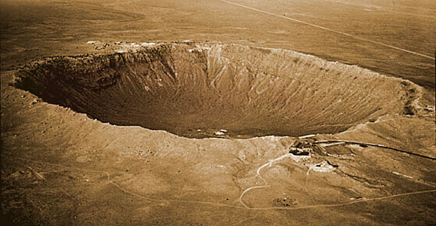
Impact Craters
Rounded depression
Caused by a meteorite

Slide 12
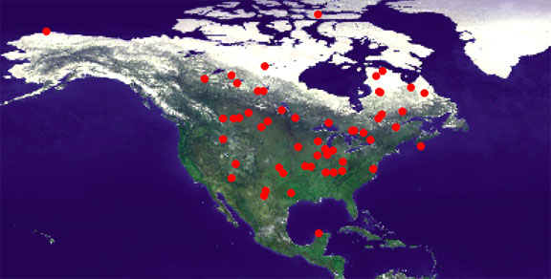

Slide 13
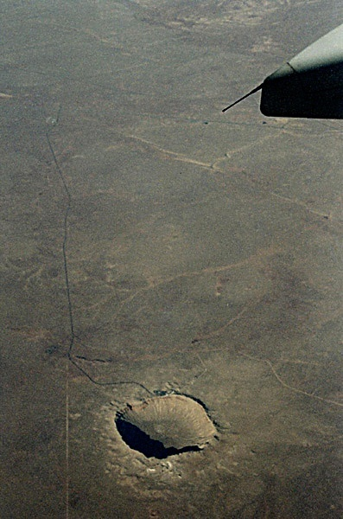

Slide 14
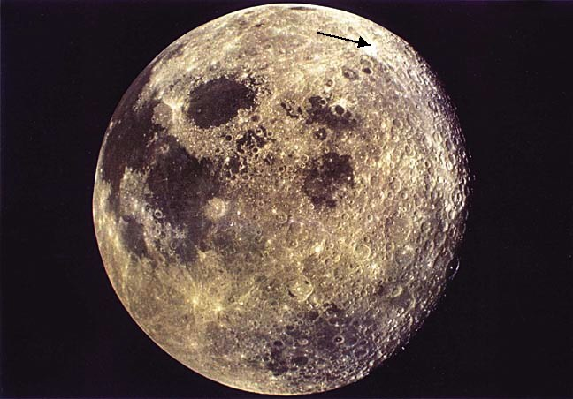

Slide 15
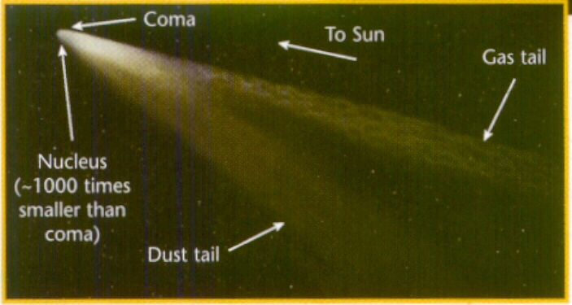
Comets
Giant dirty snowballs
  100’s to 1,000’s of years to orbit
Made of dust and frozen gases
  Ice
Orbit close to sun – Radiation vaporizes materials
  Gas and dust forms a tail

Slide 16
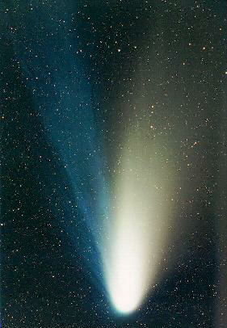

Slide 17
