Slide 1
Outer Planets
11-3

Slide 2
Gas Giants
Massive
Thick Gas
Primarily made of hydrogen and helium
Strong gravity turns gases to liquids
Liquid interiors
Small solid core

Slide 3
Outer Planets
Neptune
Uranus
Saturn
Jupiter

Slide 4
Neptune
8th planet from Sun
Ringed
Pluto occasionally crosses inside Neptune’s orbit
Atmosphere made of hydrogen, helium, and methane
Blue / Green Color

Slide 5
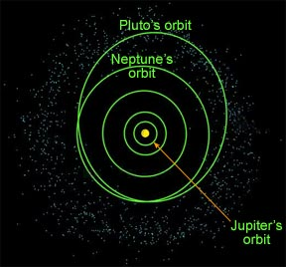
Neptune
From 1979-1999 Neptune was further away then Pluto

Slide 6
Discovered in 1846
13 moons
Active weather system
Winds 1,000 km/hr
Average temp -225 C
-373 F
Year = 164 yrs
Day = 16 hrs

Slide 7
Triton
Largest moon
Rock with an icy layer
Geysers that erupt nitrogen gas

Slide 8
Uranus
7th planet from Sun
Axis is tilted horizontally
Caused by a collision?
Thin Rings

Slide 9
Discovered in 1781
27 moons
11 rings
Year = 84 yrs
Day = 17 hrs

Slide 10
1986 – Voyager 2 space probe explored
At least 27 moons

Slide 11
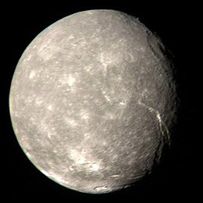
Axis and Moons
Tilt may be caused by a collision with Earth sized object
Titania – icy cracked surface that may have been covered by an ocean

Slide 12
Saturn
6th planet from the sun
Rings made of ice and rock
Size of dust to meters
Ice particles in rings may be from a moon that was shattered in a collision

Slide 13
Saturn
7 main bands of rings
2nd largest
Least dense – would float in water
90% hydrogen and 10% helium

Slide 14
Year = 29.7 years
Temp = -176 C
-285 F
At least 60 moons
Day = 10.5 hrs

Slide 15
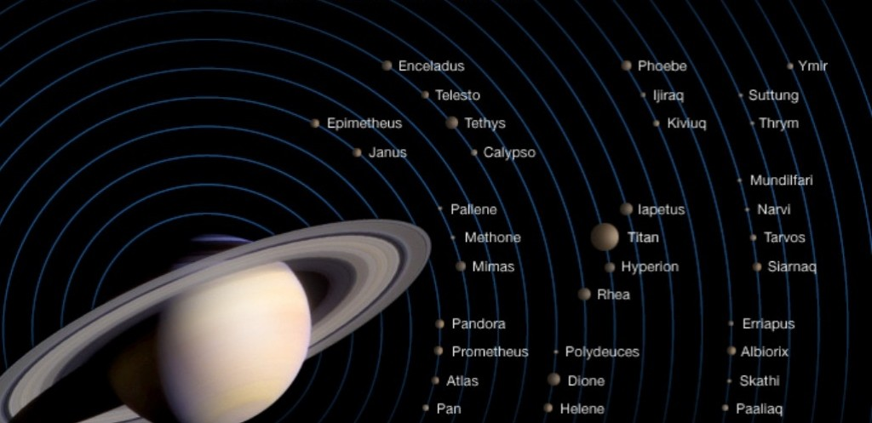

Slide 16
Saturn’s Moons
Most of the moons are large chunks of ice less than 10 km in distance
Titan – larger than Mercury
Atmosphere
Huygens probe landed in 2005

Slide 18
Jupiter
5th planet from the sun
Largest planet
63 moons
Some larger than Pluto
Io – more active volcanoes than anywhere in solar system

Slide 19
Jupiter
The Great Red Spot - A giant swirling high pressure gas storm in Jupiter’s atmosphere
Much larger than Earth
100’s of years old

Slide 20
Twice the mass of all the planets
Year = 12 years
Fastest rotation = 9.9 hours
Can you walk on these planets?

Slide 21
Hydrogen and helium
Not enough mass during formation to create a star
1,000 Earth’s would fit in Jupiter
Atmosphere is 1,000 km thick

Slide 22
Moons of Jupiter
63 moons
Galileo discovered the 4 largest moons in 1610
Galilean moons
Io, Ganymede, Callisto, Europa
Collisions with meteorites likely made the faint rings

