Slide 1
11-2
Inner Planets

Slide 2
Terrestrial Planets
Solid and rocky
Metallic cores
Planets closest to the Sun
Impact craters

Slide 3
Mars
4th planet from the sun
Probes sent to explore planet
Polar ice caps
Signs that once had liquid water

Slide 4
Year = 687 days
Day = 24 hours 37 mins
Volcanic activity
Valleys eroded by water
2 Moons

Slide 5
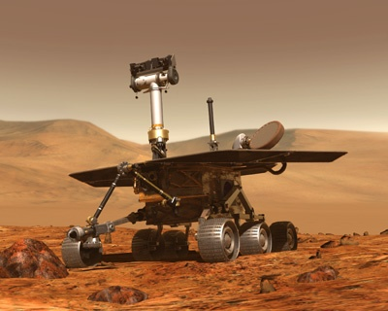

Slide 6
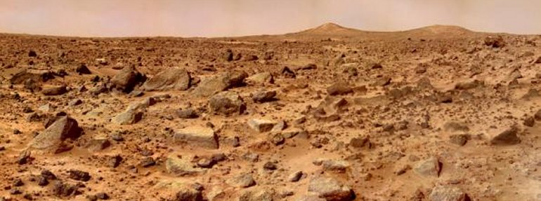
Mars
Red Planet – looks red due to iron oxide on surface

Slide 7
The Face on Mars

Slide 8
The Face on Mars
Martian sculpture?
New images show eroded raised surface

Slide 9
Volcanoes 100 larger than Earth’s
Olympus Mons – 3 times larger than Everest
No tectonic plates

Slide 10
Still active volcanoes?
Marsquakes – Viking craft landed to detect

Slide 11
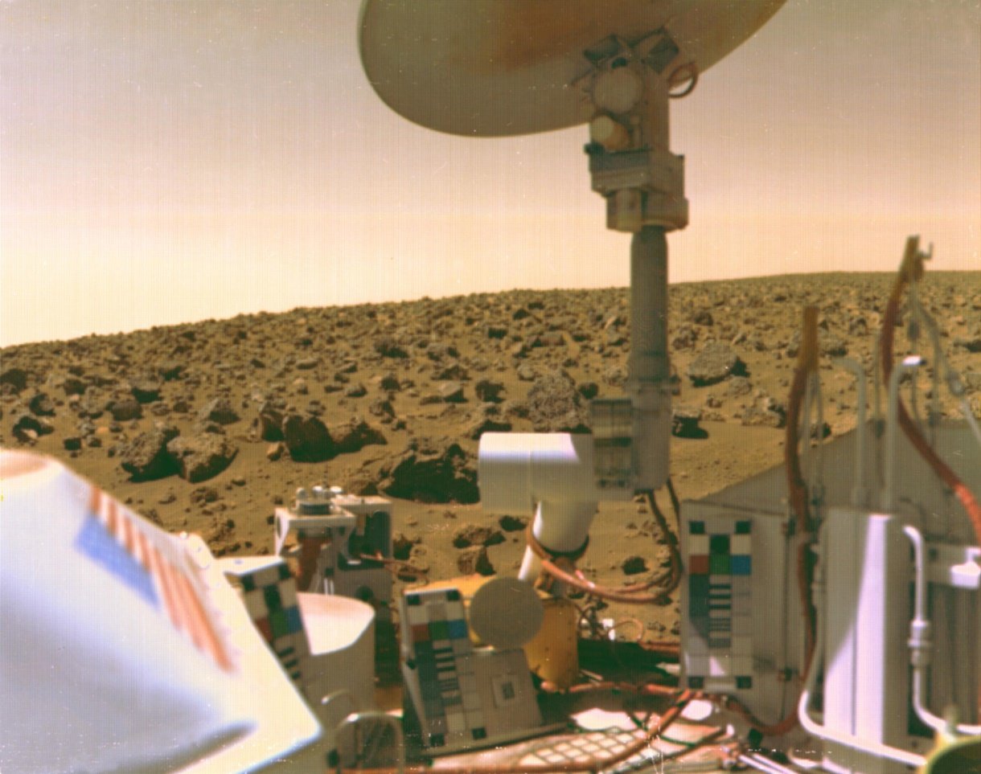

Slide 12
Water?
Pressure and temperature too low for liquid water
Icecaps and subsurface
Rovers – Spirit and Opportunity
Evidence for past liquid water

Slide 13
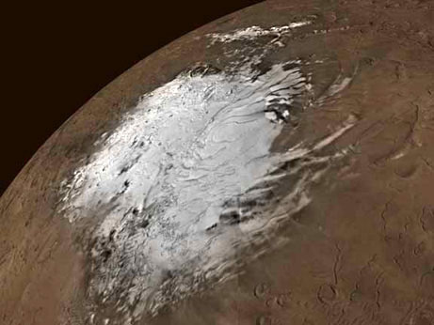

Slide 15
Earth
3rd planet from sun
Water exists as a liquid, solid, and gas
Atmosphere keeps UV rays out
Only planet with life

Slide 16
Venus
2nd planet
Greenhouse effect - Thick clouds trap heat
878 F
Hotter than Mercury
Rains sulfuric acid

Slide 17
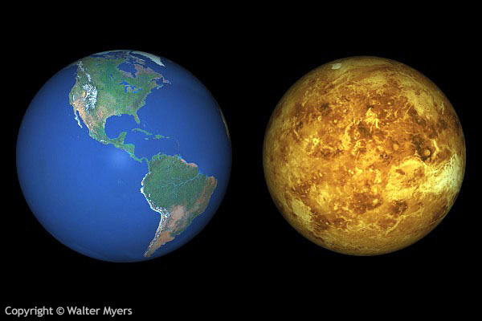
Twinsies!

Slide 18
Year = 225 days
Day = 244 days
A day is longer than a year.
90 times the pressure of Earth
96% CO2 atmosphere
Rotates east to west
No Moons

Slide 19
Probes
1970’s – Soviet Union
Basalt and Granite
1990’s – US
Orbit for 4 years
Radio waves of surface
Crashed to collect atmospheric data

Slide 20
Magellan
Mountains, volcanoes, lava plains, sand dunes
Young craters
Massive volcanic resurfacing

Slide 21
Mercury
Closest to the sun
Smooth plains and high cliffs
Lots of craters on surface

Slide 22
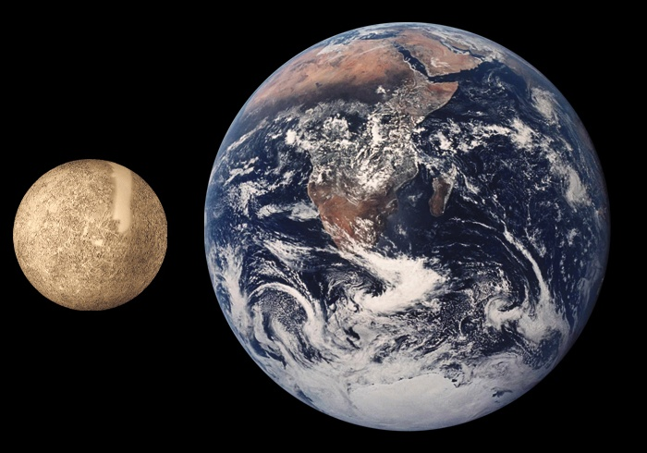

Slide 23
Year = 88days
Day = 59 days
No moons
Large cliffs – wrinkles when molten
427 C
-173 C
Little to no atmosphere
No wind

